Slide 1
TEACHER CUE
CFU
HINT
Scaffolding for students
MAKE THE CONNECTION
Allow students to make the connection

Slide 2
We will be revising Geology content for the term
TRACK WITH ME
READ WITH ME
I can complete questions based on geology

Slide 3
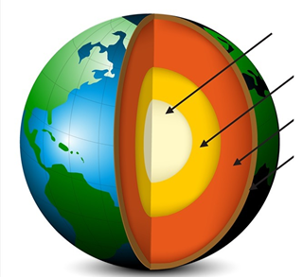
Label the layers of the Earth

Slide 4
MAKE THE CONNECTION
Mineral Rock
Finish the sentence
____________ is a naturally occurring substance
_____________ is made up of one or more minerals

Slide 5
A rock is a ____________ substance made up of one or more ____________ and is formed by ____________ processes.
solid, minerals, biological
Liquid, cells, geological
Solid, cells, biological
Solid, minerals, geological

Slide 6
Which of the following are rocks?
Soil
Marble
Bricks
Wood

Slide 7
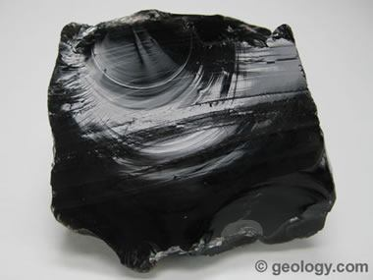
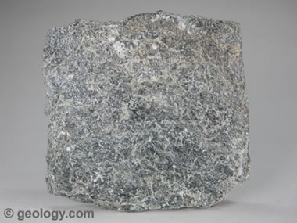
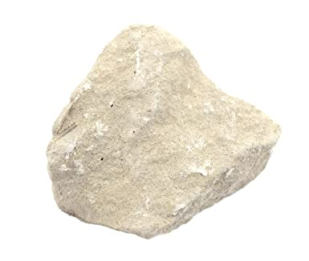
Which are the three types of rock?

Slide 8
Match the type of rock to how they are formed
Metamorphic
Sedimentary
Igneous
Formed from heat and pressure
Formed from the broken remains of other rocks
Formed from cooling magma or lava

Slide 9
MAKE THE CONNECTION
Extrusive Small Intrusive Quickly Slowly Large
Igneous Rocks
Fill in the blank
___________ igneous rocks are those that cool down from lava. These make __________ crystals as they cool down ________.
____________ igneous rocks are those that cool down from magma. These make ___________ crystals as they cool down ___________.

Slide 10
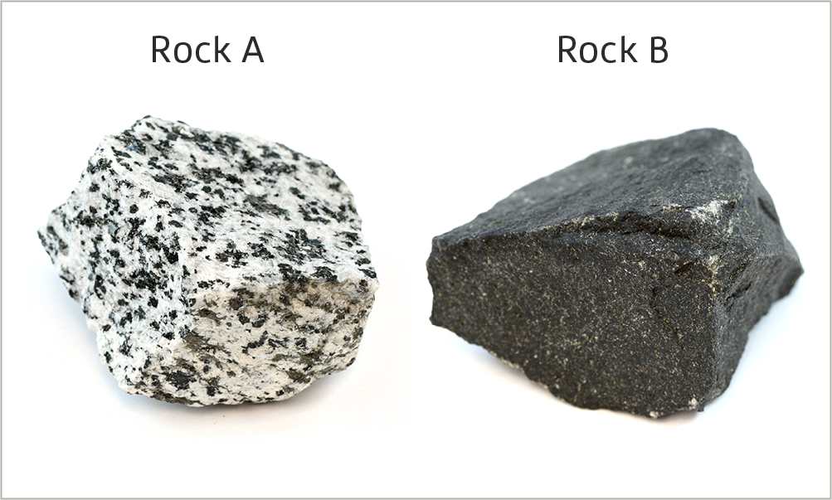
Diorite is an igneous rock that forms when magma cools slowly underneath the Earth's surface. Basalt is an igneous rock that forms when lava cools quickly on the Earth's surface.
Identify which rock shown on the left is diorite and which one is basalt. Justify your answer based on what you can observe.

Slide 11
Sedimentary rocks
Recall the difference between weathering and erosion.
Weathering is gradual, erosion is sudden
Weathering breaks down rock, erosion occurs on the surface
Weathering occurs deep underground, erosion occurs on the surface
Weathering doesn’t involve the movement of rock particles, erosion does

Slide 12
Identify which of the following processes form sedimentary rocks.
The burial of the remains of marine organisms
The heating and compression of rocks deep below the surface
The cooling of molten rock following a volcanic eruption
The burial of mud, sand and pebbles produced when exposed rocks are broken down

Slide 13
Which type of rock is most likely to contain contain fossils?
Igneous
Metamorphic
Sedimentary

Slide 14
Recall which one of the following processes forms metamorphic rocks.
A. The burial and heating of the remains of dead plants
B. The slow cooling of magma deep below the surface
C. The heating and compression of rocks deep below the surface
D. The burial and compaction of sediment

Slide 15
Identify which of the following types of rock can form metamorphic rocks.
A. Sedimentary rocks
B. Igneous rocks
C. Other metamorphic rocks

Slide 16
Fill in the following table
Type of rock | How it forms

Slide 17
Classify the rocks below into igneous, sedimentary and metamorphic
Schist
Granite
Sandstone
Limestone
Obsidian
Gneiss
Breccia
Basalt
Marble
Pumice

Slide 18
Complete the following table
Heat and pressure | Forms
Weathering and erosion | Forms
Cooling of magma or lava | Forms
Melting | Forms
Compaction and cementation | Forms

Slide 19
A metamorphic rock lies deep in the Earth's crust where it slowly melts. The molten rock erupts out of a volcano and hardens.
Define what it has become.
Metamorphic rock
Magma
Sedimentary rock
Igneous rock

Slide 20
A sedimentary rock experiences intense heat and pressure during the formation of a high mountain range.
Define what it has become.
Igneous rock
Metamorphic rock
Sedimentary rock
Magma

Slide 21
Select the option that best completes the following sentence. For sedimentary rock to turn into igneous rock, it must be:
Exposed to heat and pressure
Broken down by wind, rain or ice
Melted to form magma, and then cooled
Cemented and compacted together

Slide 22
Decide which of the following steps cannot occur in the rock cycle.
metamorphic rock → sediment
sediment → igneous rock
sedimentary rock → metamorphic rock
magma → igneous rock

Slide 23
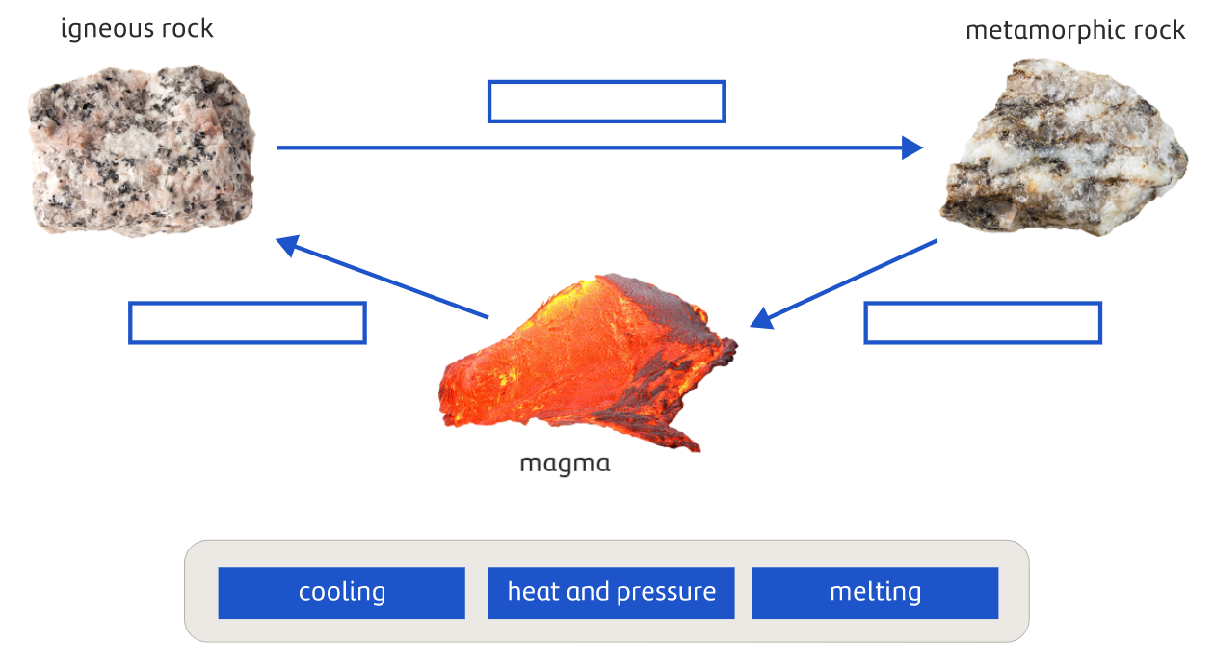

Slide 24
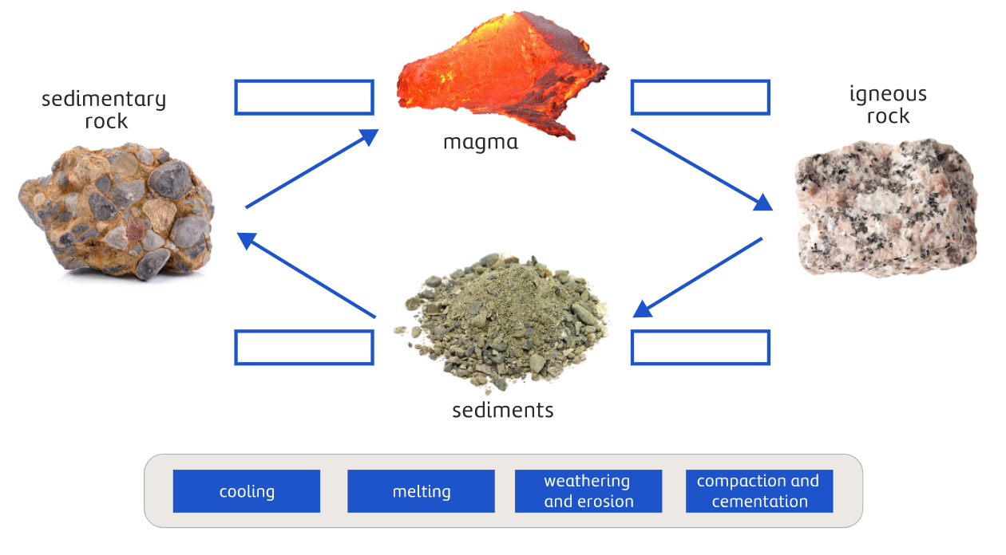

Slide 25
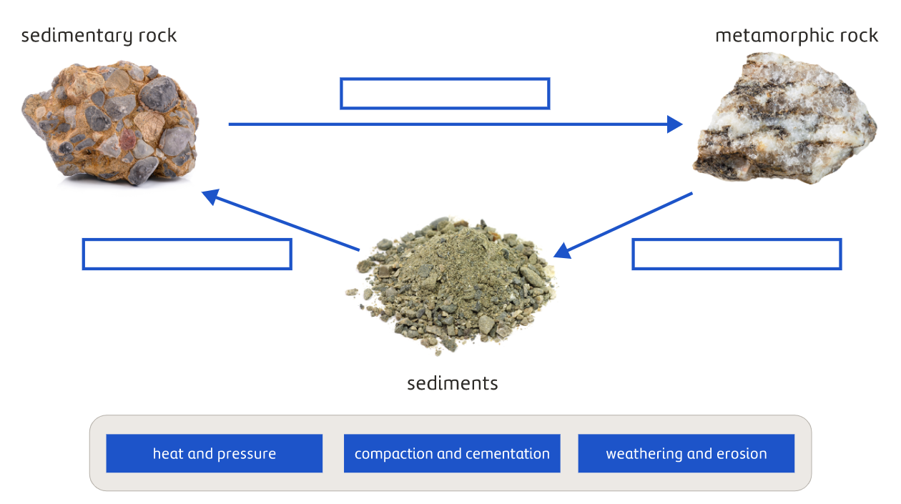

Slide 26


Slide 27
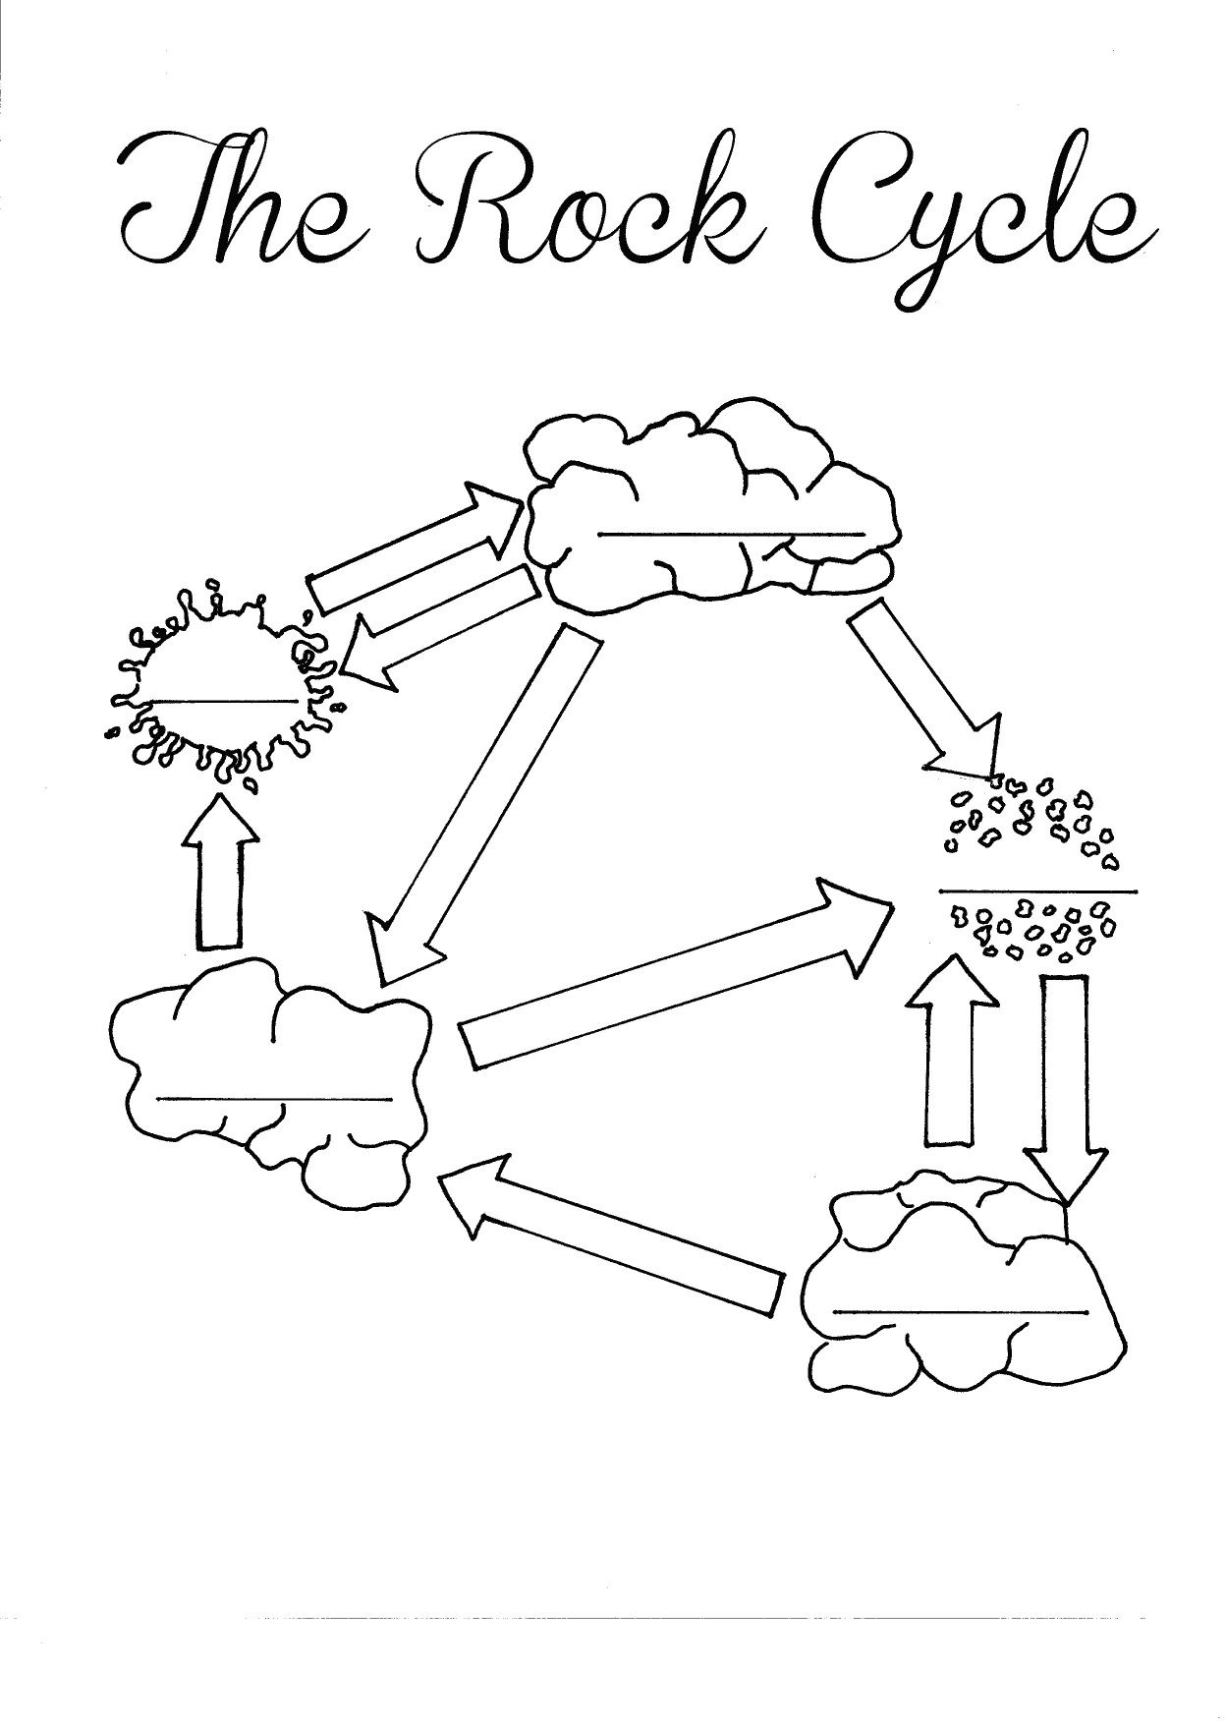
Label the rock cycle

Slide 28
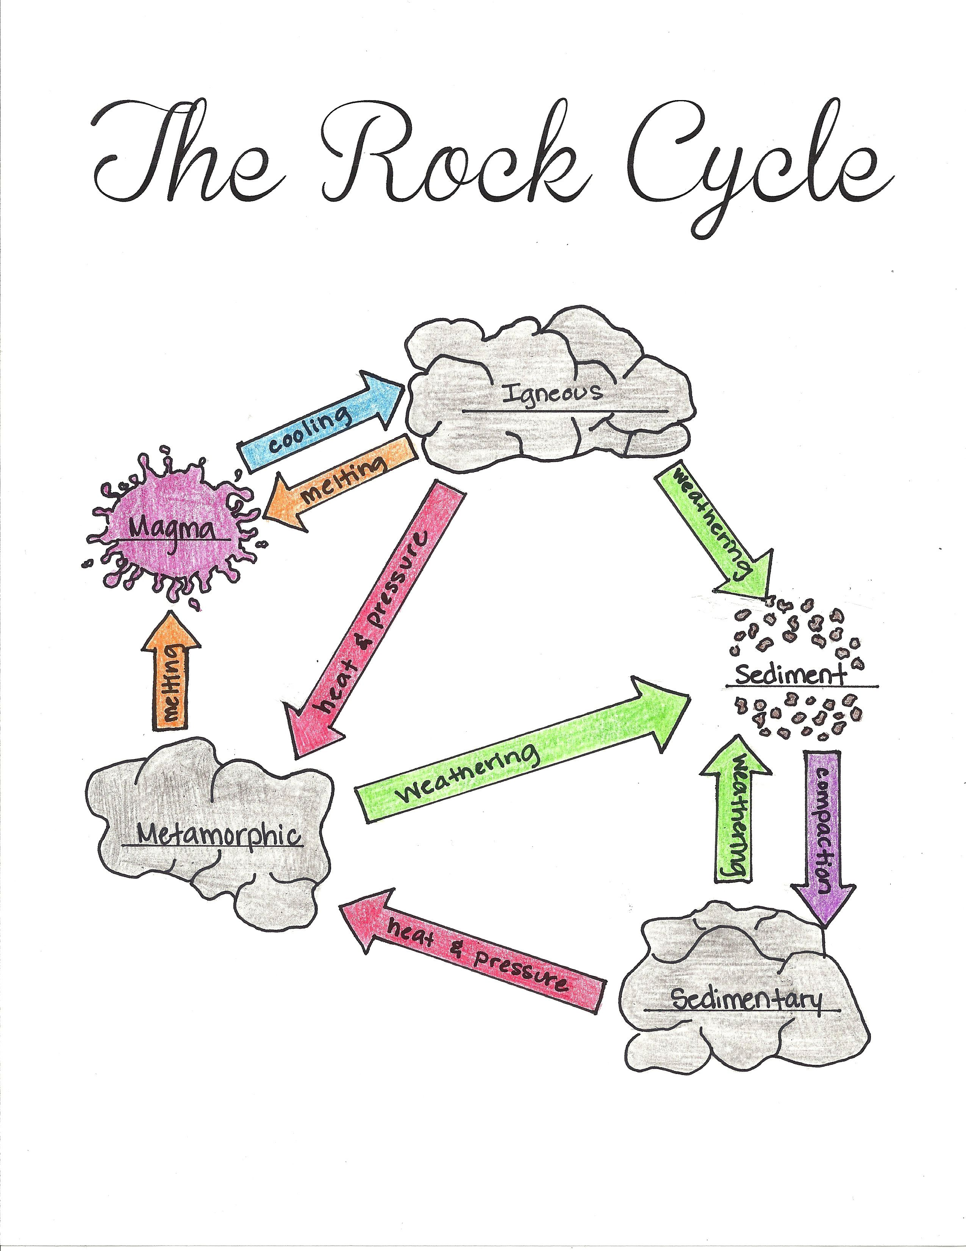
Label the rock cycle

Slide 29
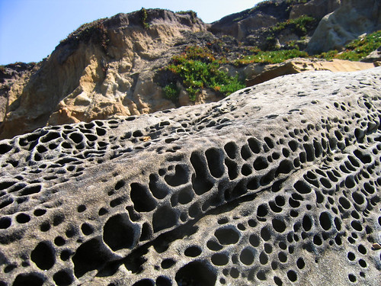
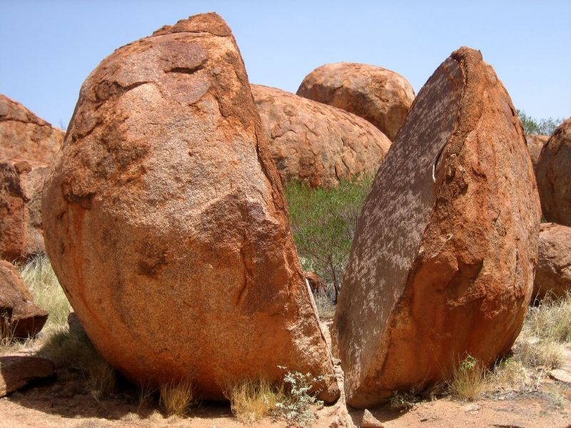
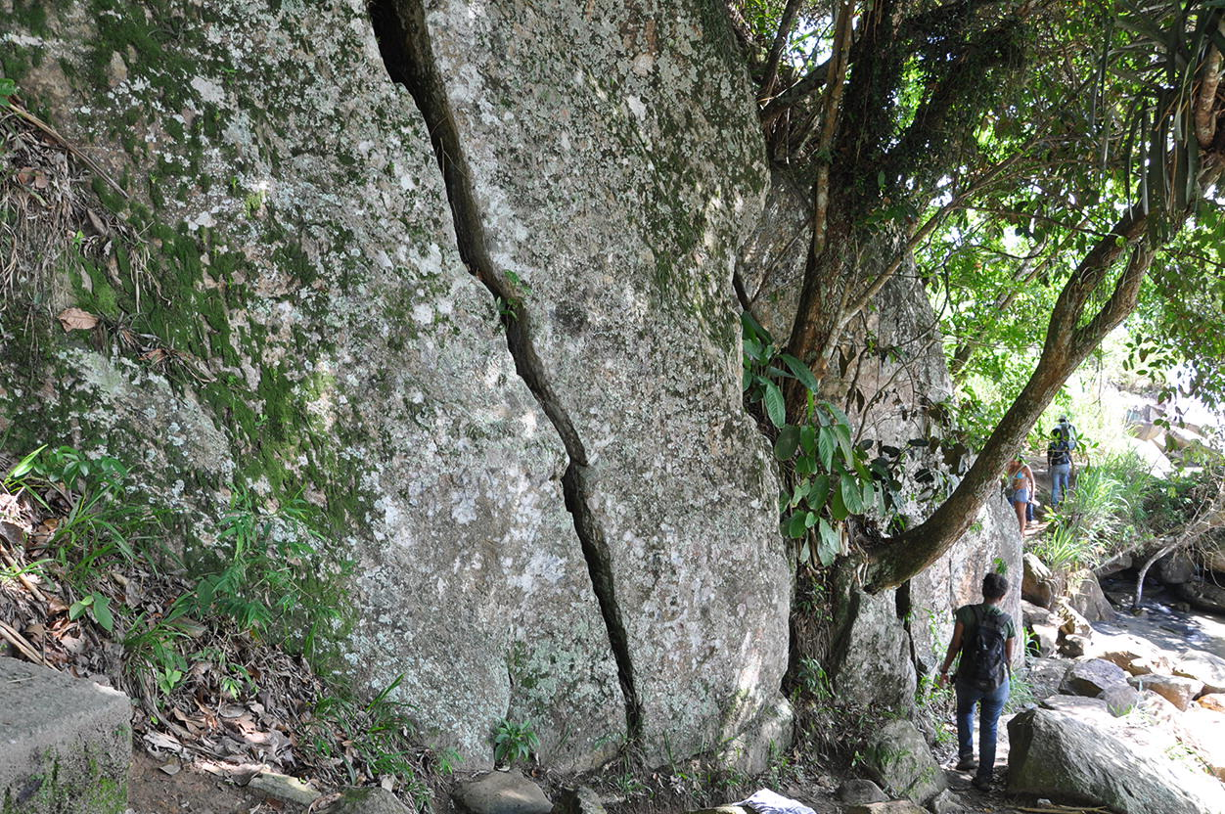
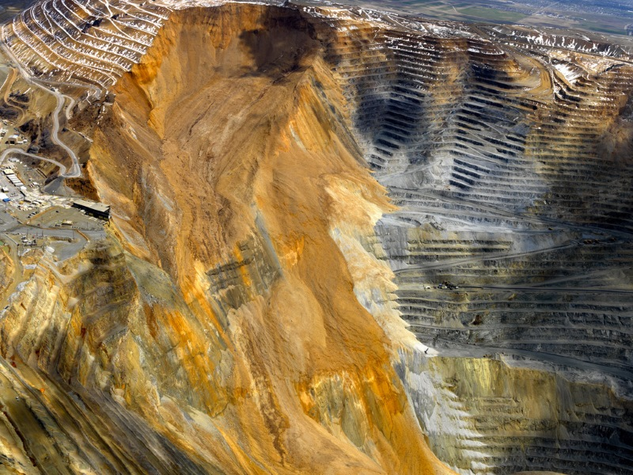
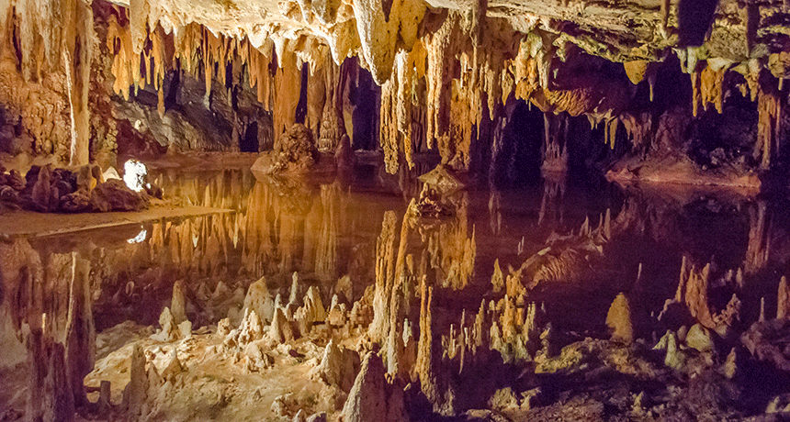
MAKE THE CONNECTION
Physical Biological Chemical
Select the correct type of weathering

Slide 30
Finish the sentence
Porosity is the amount of ____________ in a rock. It is usually measured by the amount of ______________ a rock can ________________.

Slide 31
Which of the following rocks reacts with acid?
Granite
Marble
Basalt
Using this information which rock type would be used in buildings in a city and why?

Slide 32
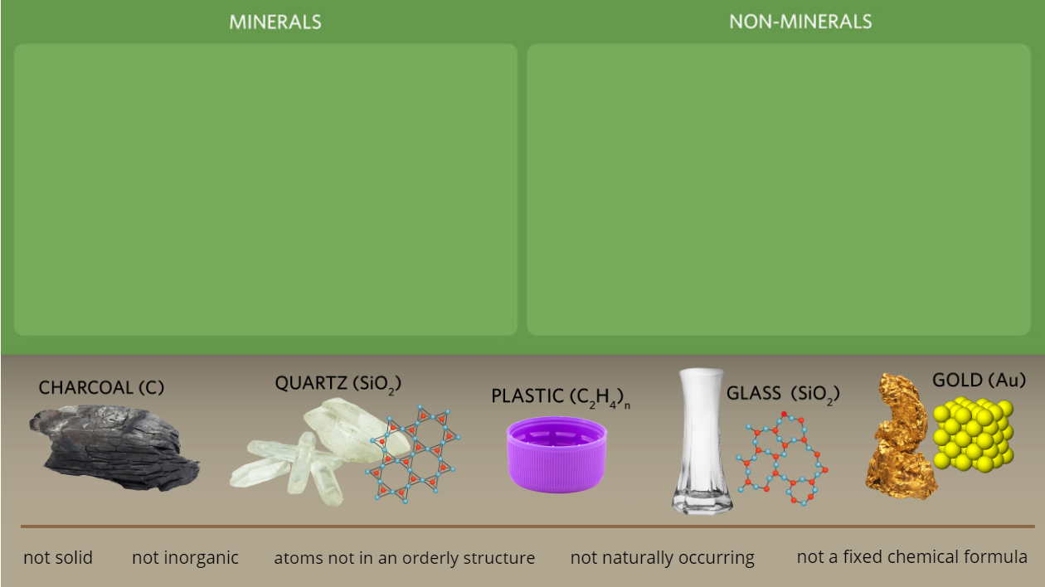
Put the words and images into the correct column

Slide 33
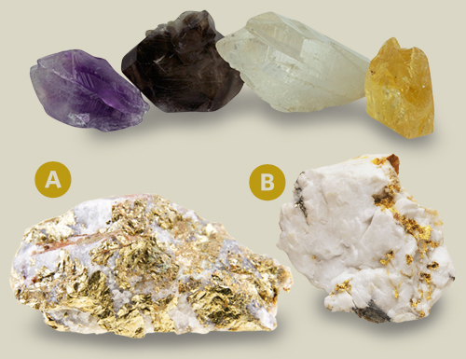
Which sample do you think is the gold A or B?

Slide 34
Match the following mineral properties to the correct term
Lustre
Colour
Hardness
Cleavage
How a mineral breaks along lines of weaknesses, leaving flat surfaces
This is not a useful way to classify as there can be large variation amongst one mineral
The way light interacts with the surface of the mineral
Commonly measured using Moh’s scale

Slide 35
Put the following steps involved in obtaining a mineral from the Earth in order
Enrichment
Extraction
Exploration
Mining

Slide 36
Finish the sentence
An ore contains ____________ that are _________________.

Slide 37
MAKE THE CONNECTION
Oxygen Organic Carbon Millions Plant
Finish the sentence
Coal is __________ matter made from ___________. This is made from _________ remains in swampy areas that have little _______________ formed _________________ of years ago.

Slide 38
Circle those that an Environmental impact assessment considers
Noise levels
Impact on animals and plants
Employment of individuals from local committees
Name of the mine
Plan for erosion and runoff
The rosters of the miners

Slide 39
We will be revising Geology content for the term
TRACK WITH ME
READ WITH ME
I can complete questions based on geology

